Slide 1
A parallel multistart algorithm for the closest string problem
Fernando C. Gomes, Cláudio N. Meneses, Panos M. Pardalos,
Gerardo Valdisio R. Viana
Computers & Operations Research 35 (2008)
Speaker: Chun-Jen Chen
Date: Aug. 6, 2008

Slide 2
Abstract
In this paper we describe and implement a parallel algorithm to find approximate solutions for the Closest String Problem (CSP). The CSP, also known as Motif Finding problem, has applications in Coding Theory and Computational Biology. The CSP is NP-hard which motivates us to think about heuristics to solve large instances. Several approximation algorithms have been designed for the CSP, but all of them have a poor performance guarantee.
115/11/07

Slide 3
Abstract
Recently some researchers have shown empirically that integer programming techniques can be successfully used to solve moderate-size instances (10–30 strings each of which is 300–800 characters long) of the CSP. However, real-world instances are larger than those tested. In this paper we show how a simple heuristic can be used to find near-optimal solutions to that problem. We implemented a parallel version of this heuristic and report computational experiments on large-scale instances. These results show the effectiveness of our approach.
115/11/07

Slide 4
Hamming Distance
Hamming Distance
Ex: a = ACTACT
b = CCACCA
∵有4個位置不同
∴Hamming Distance = 4.
115/11/07

Slide 5
Closest String Problem
S₁ = ACGT
S₂ = TTAC
S₃ = CCGC
Closest String is TCGC and it has d = 2.
( d₁=2, d₂=2, d₃=1 )
EX: ACGC have d₁=1, d₂=3, d₃=1
115/11/07

Slide 6
Algorithm 1.
S₁ = ACGT
S₂ = TTAC
S₃ = CCGC
S = S₃ = CCGC because S₃ is the closest to all other string.
Selecting any string in S as a solution gives a 2-approximation algorithm (see [4])
2
d₁ = 4
4
4
d₂ = 4
3
3
2
d₃ = 3
115/11/07

Slide 7
Local Search
S₁ = ACGTAT d₁=3
S₂ = TATCGT d₂=4
S₃ = ACTCAG d₃= 0
S = ACTCAG
115/11/07

Slide 8
Local Search
S₁ = ACGTAT d₁=3 -> 4
S₂ = TATCGT d₂=4 -> 3
S₃ = ACTCAG d₃= 0 -> 1
S = ACTCAG
115/11/07

Slide 9
Local Search
S₁ = ACGTAT d₁=4
S₂ = TATCGT d₂=3
S₃ = ACTCAG d₃=1
S = TCTCAG
115/11/07

Slide 10
Local Search
S₁ = ACGTAT d₁=4 -> 5
S₂ = TATCGT d₂=3 -> 2
S₃ = ACTCAG d₃=1 -> 2
S = TCTCAG
115/11/07

Slide 11
Local Search
S₁ = ACGTAT d₁=4 -> 5
S₂ = TATCGT d₂=3 -> 2
S₃ = ACTCAG d₃=1 -> 2
S = TCTCAG
115/11/07

Slide 12
Local Search
S₁ = ACGTAT d₁=4 -> 3
S₂ = TATCGT d₂=3 -> 2
S₃ = ACTCAG d₃=1 -> 2
S = TCTCAG
115/11/07

Slide 13
Local Search
S₁ = ACGTAT d₁=3
S₂ = TATCGT d₂=2
S₃ = ACTCAG d₃=2
S = TCTCAT
115/11/07

Slide 14
Local Search
S₁ = ACGTAT d₁=3
S₂ = TATCGT d₂=2
S₃ = ACTCAG d₃=2
S = TCTCAT
115/11/07

Slide 15
Local Search
S₁ = ACGTAT d₁=3 -> 2
S₂ = TATCGT d₂=2 -> 3
S₃ = ACTCAG d₃=2 -> 1
S = TCTCAT
115/11/07

Slide 16
Local Search
S₁ = ACGTAT d₁=2
S₂ = TATCGT d₂=3
S₃ = ACTCAG d₃=1
S = ACTCAT
115/11/07

Slide 17
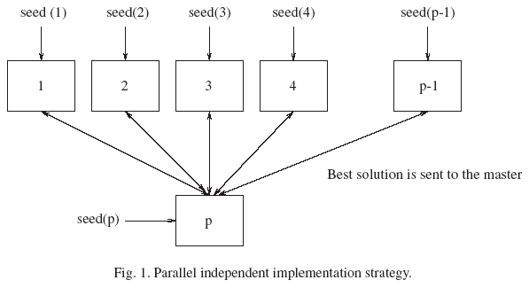
115/11/07

Slide 18
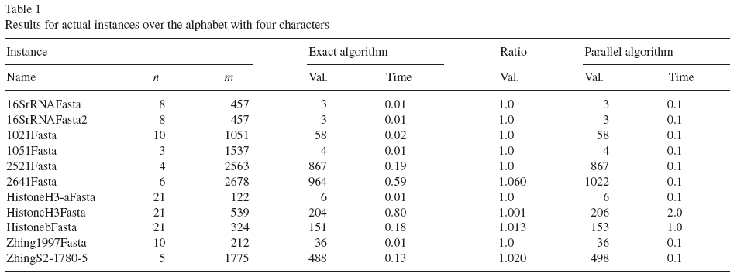
Experimental Result
115/11/07

Slide 19
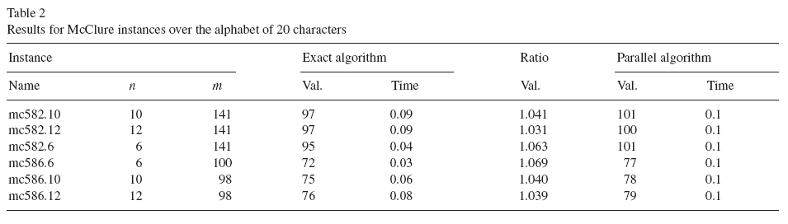
Experimental Result
115/11/07

Slide 20
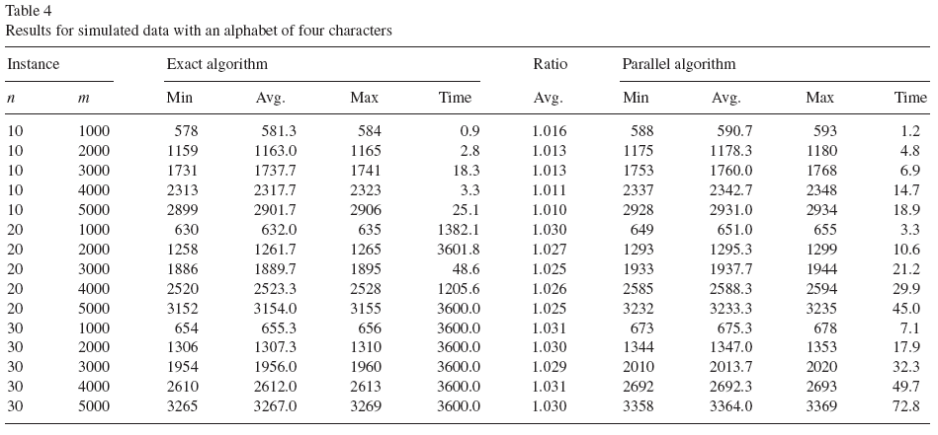
Experimental Result
115/11/07

Slide 21
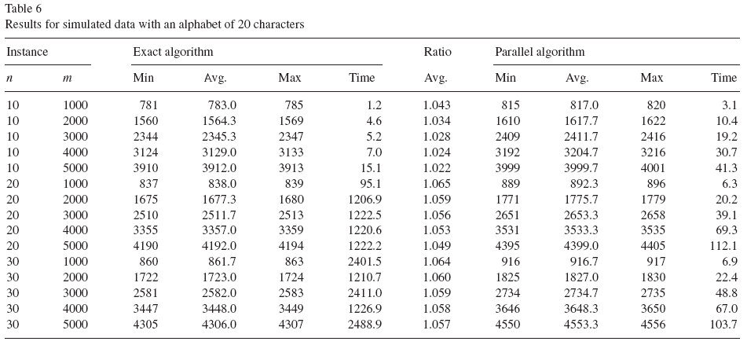
Experimental Result
115/11/07

